Slide 1
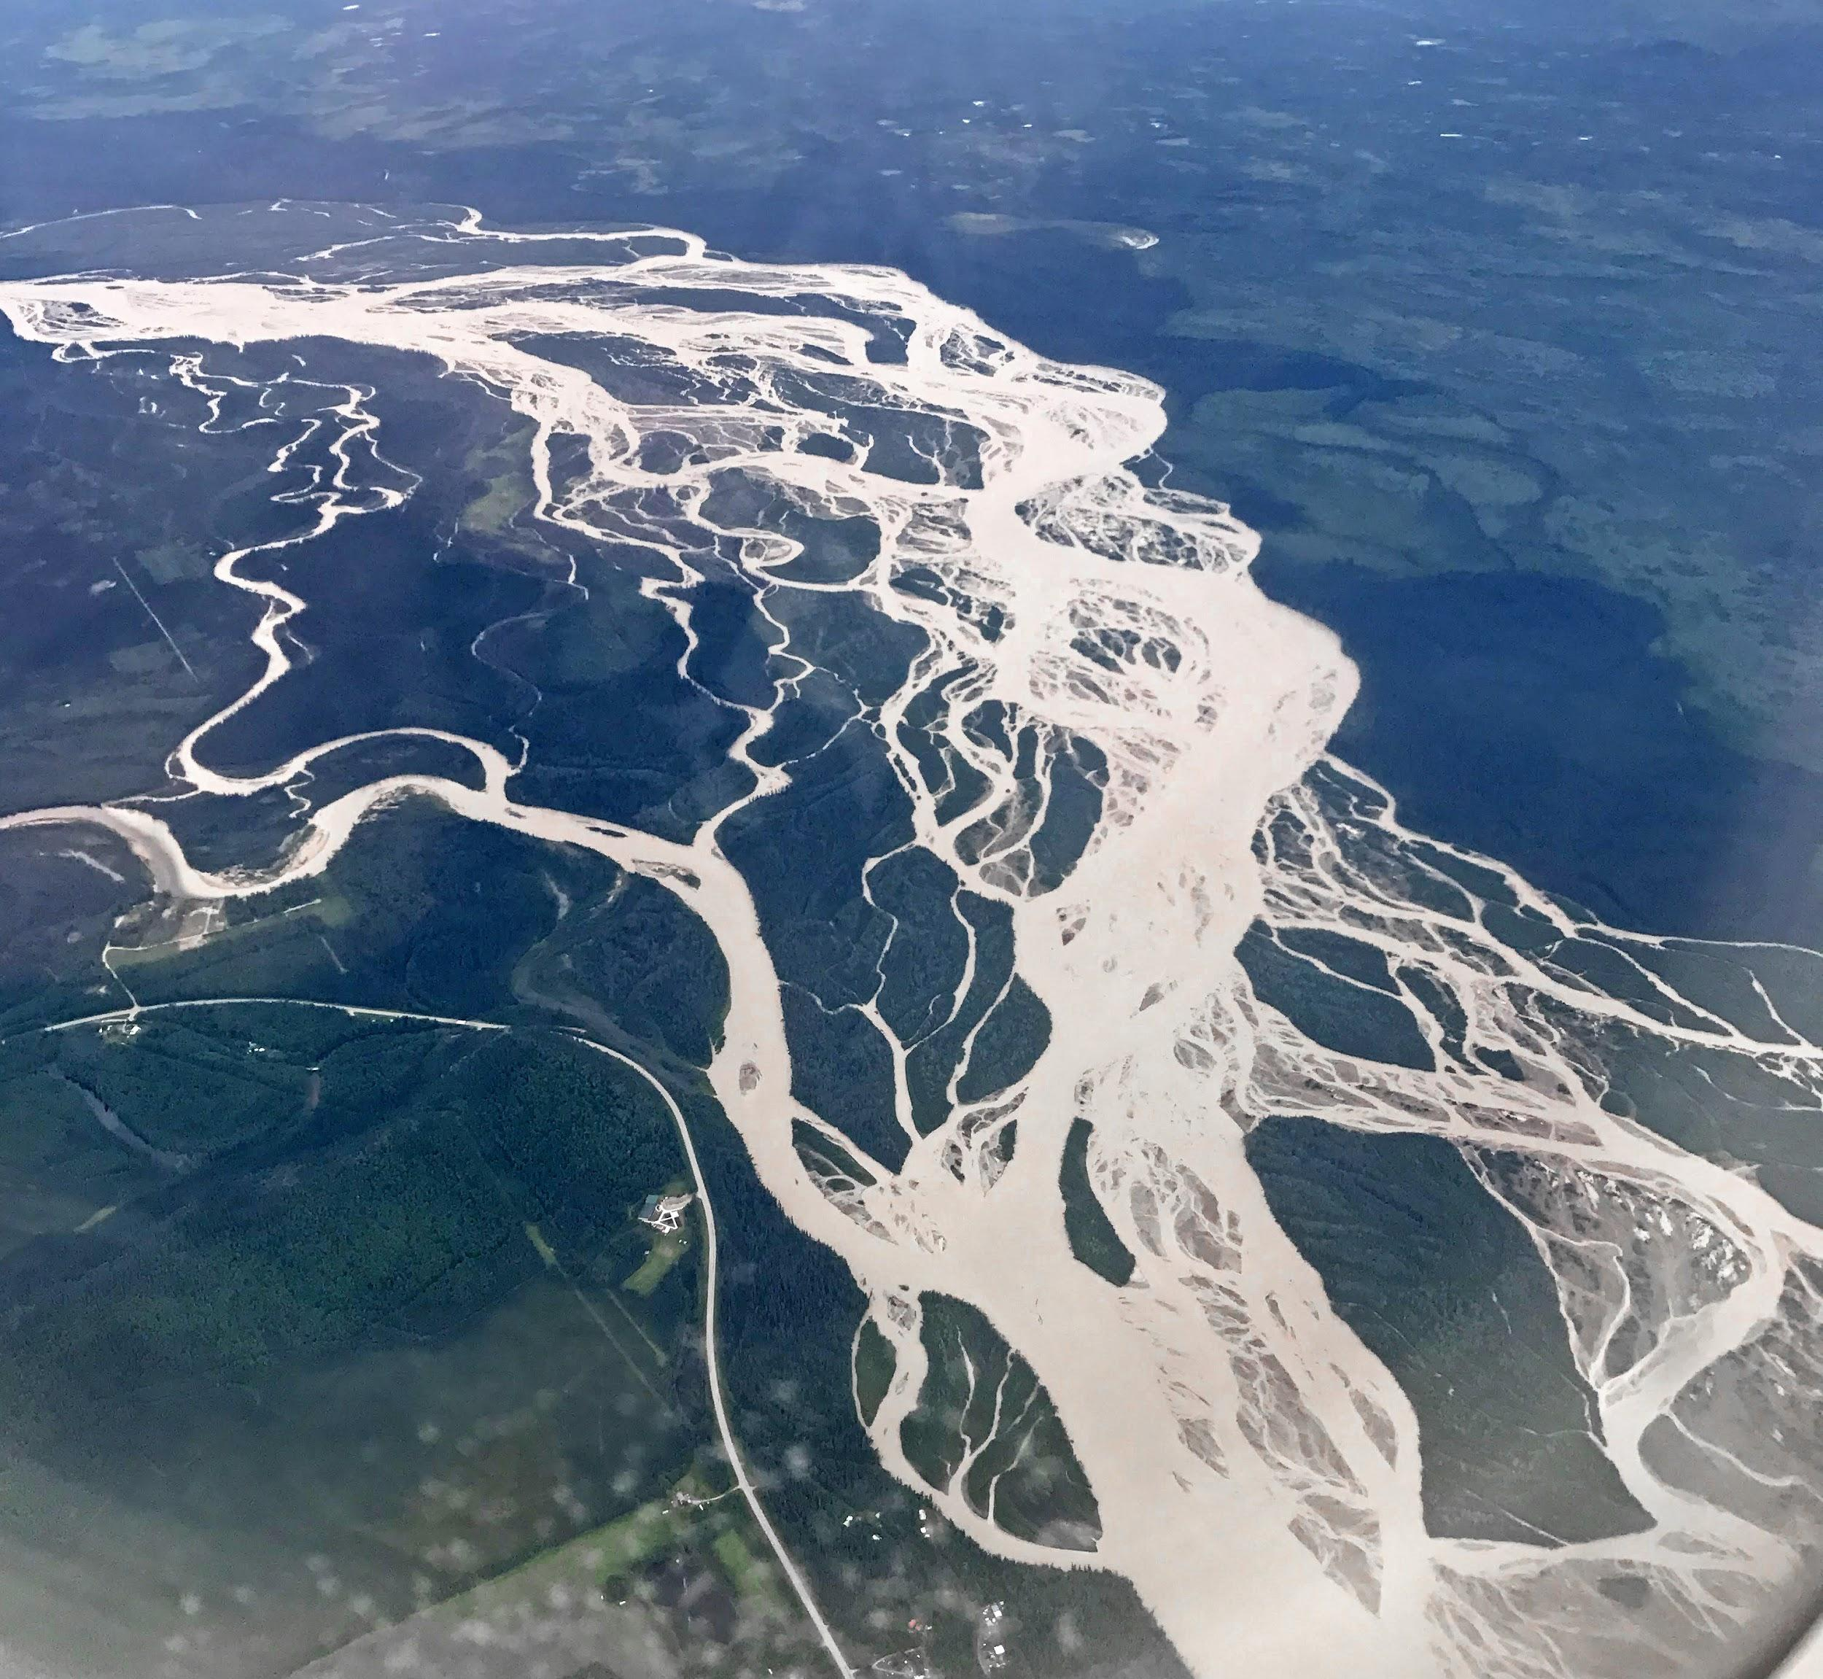

Connections between Streamflow Response and Hydroclimatic Changes in Arctic Rivers
Dylan Blaskey
Department of Civil Engineering
University of Colorado Boulder
Collaborators:
Dr. Keith Musselman, University of Colorado Boulder
Dr. Michael Gooseff, University of Colorado Boulder
Dr. Josh Koch, USGS

Slide 2
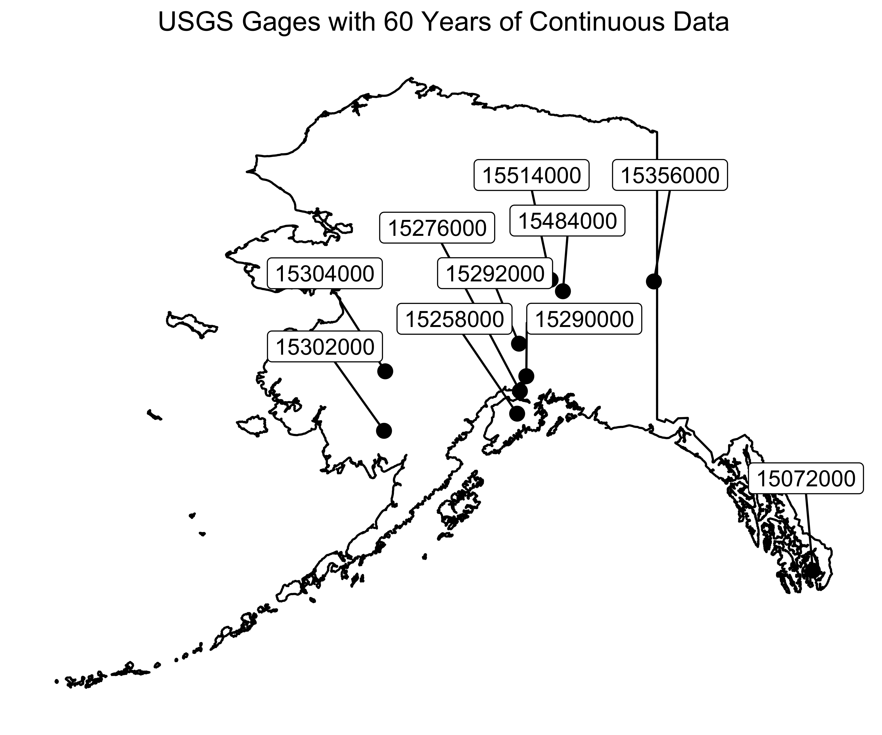

Slide 3
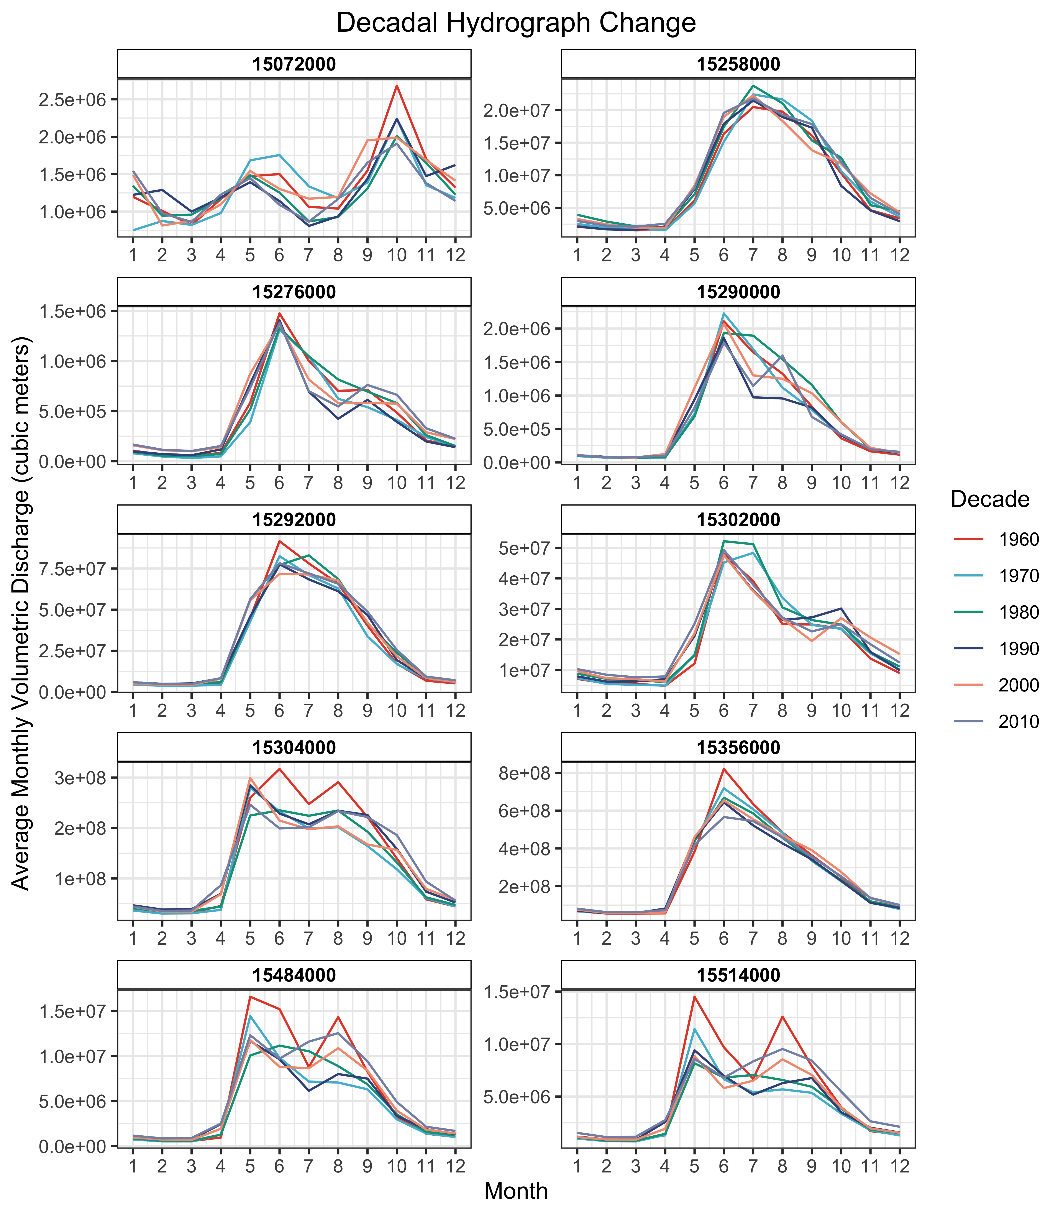

Slide 4
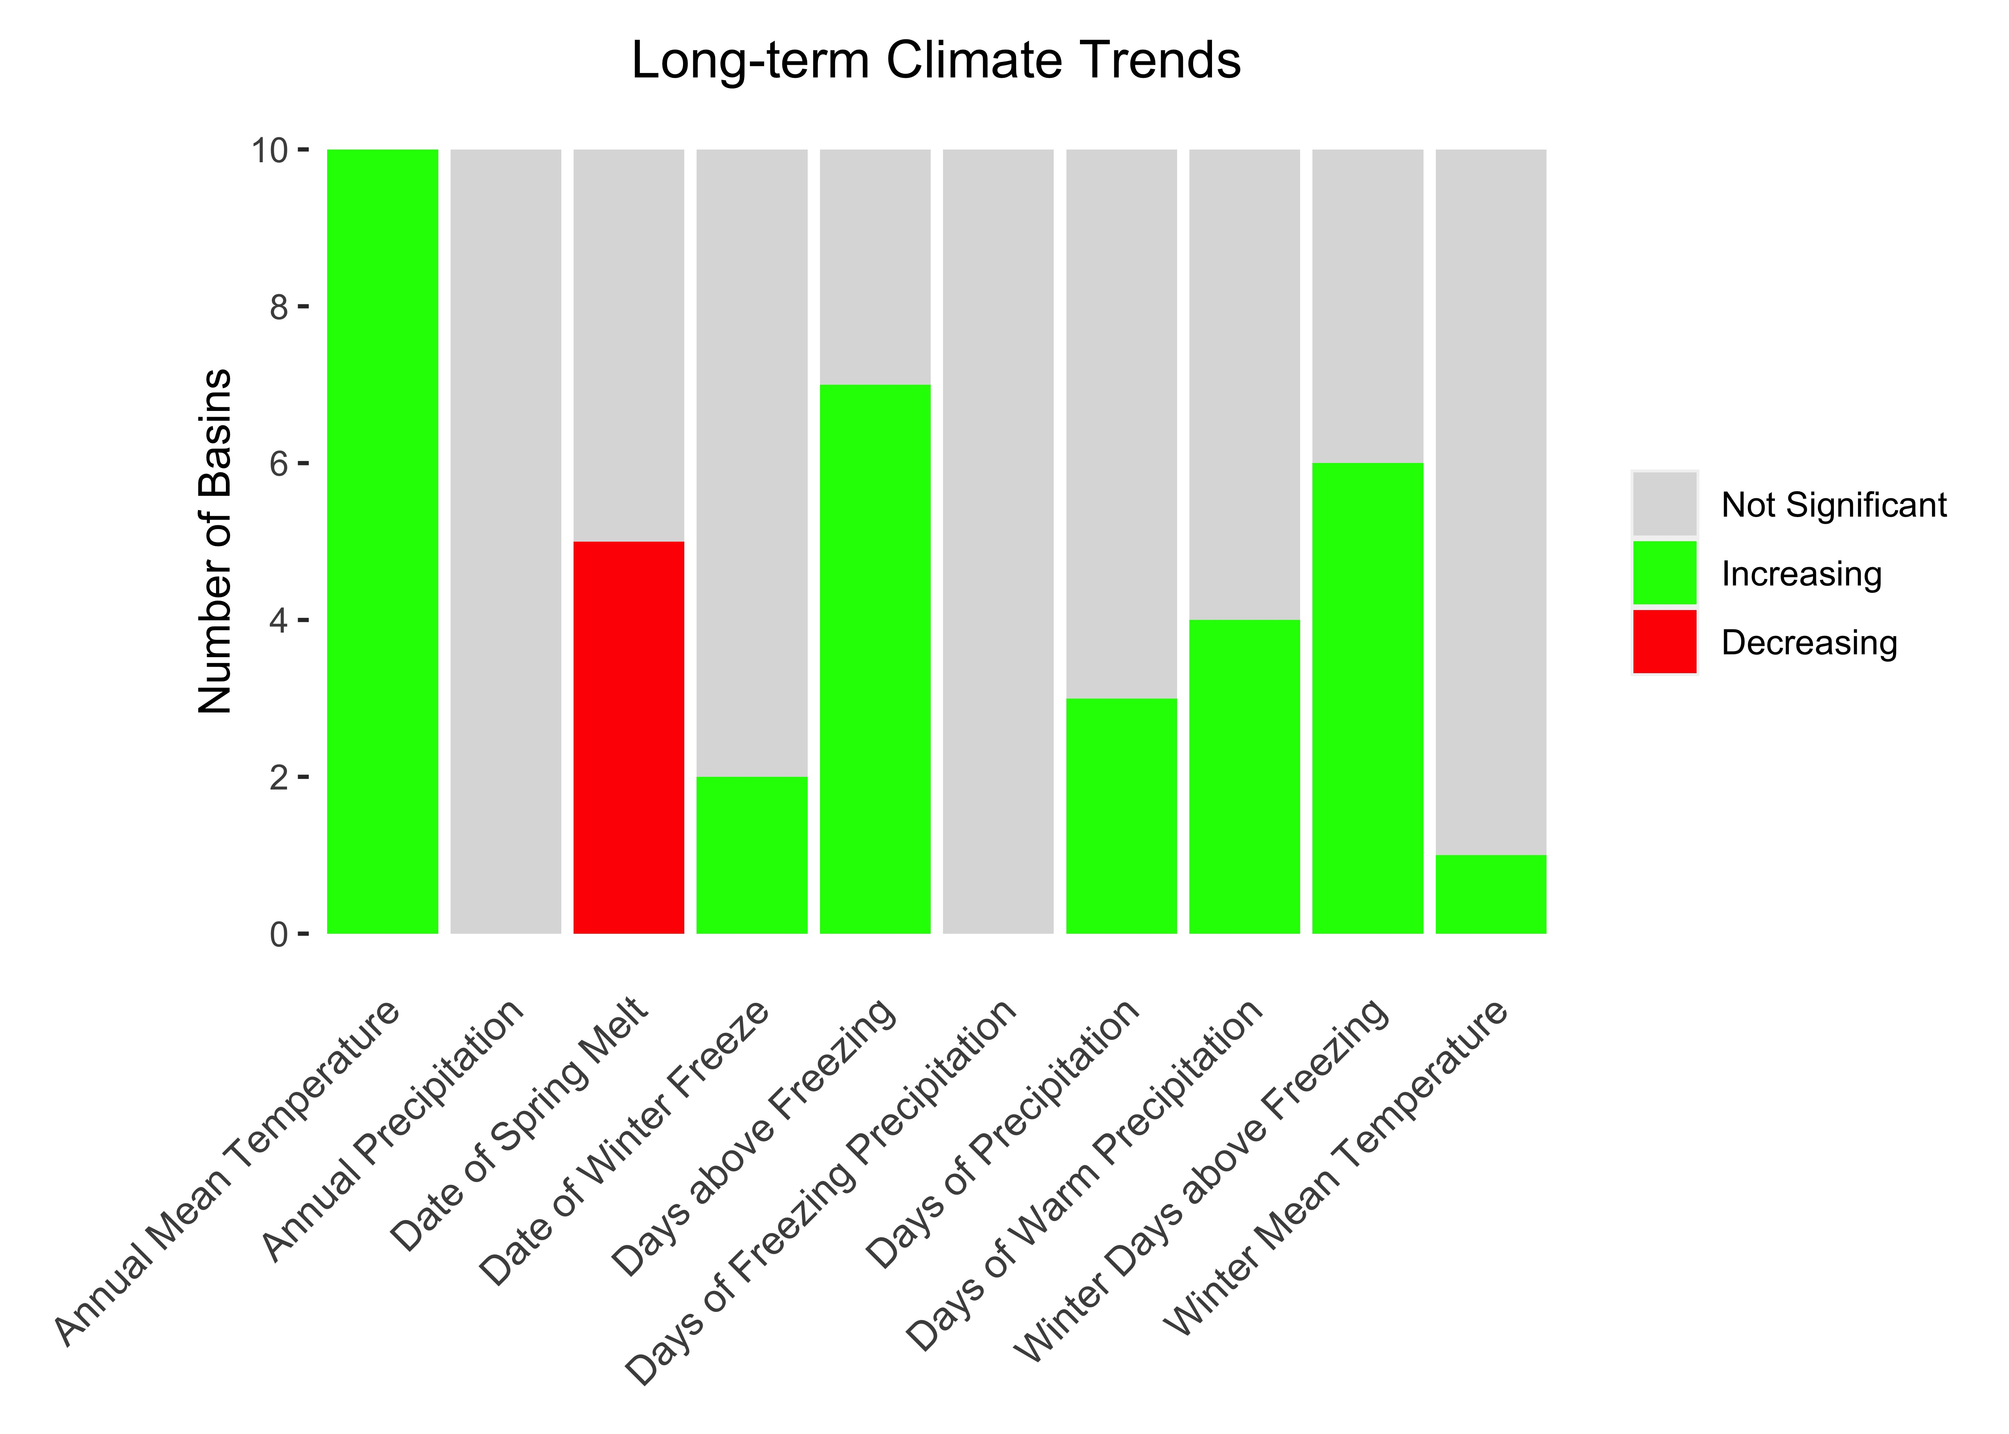
Frozen Period Decreasing Due to Warming

Slide 5
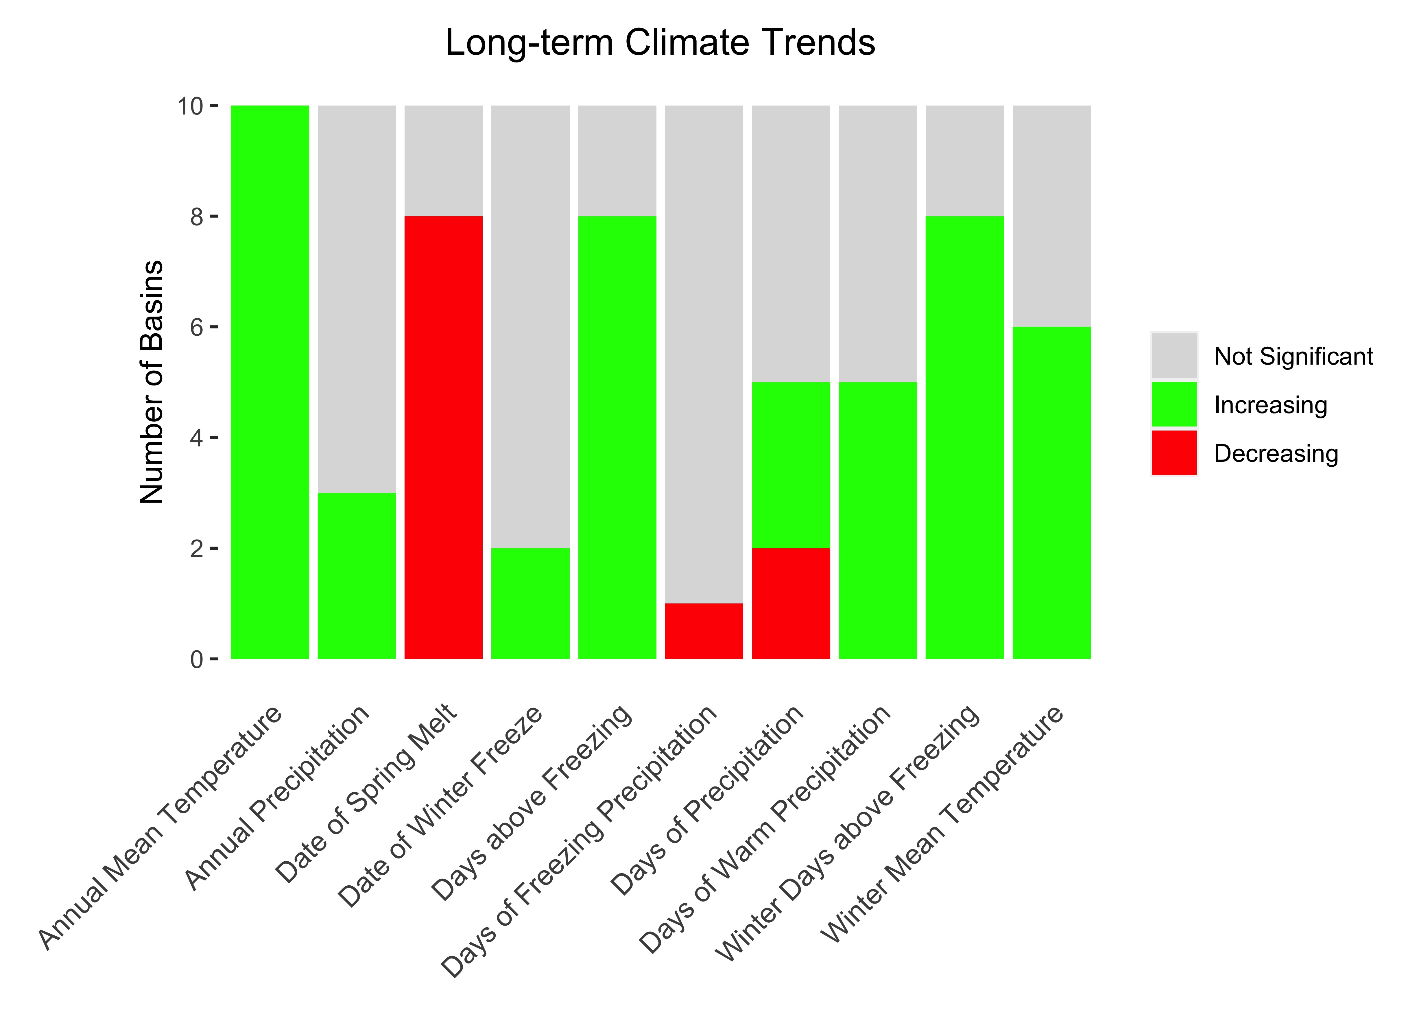
Frozen Period Decreasing Due to Warming

Slide 6
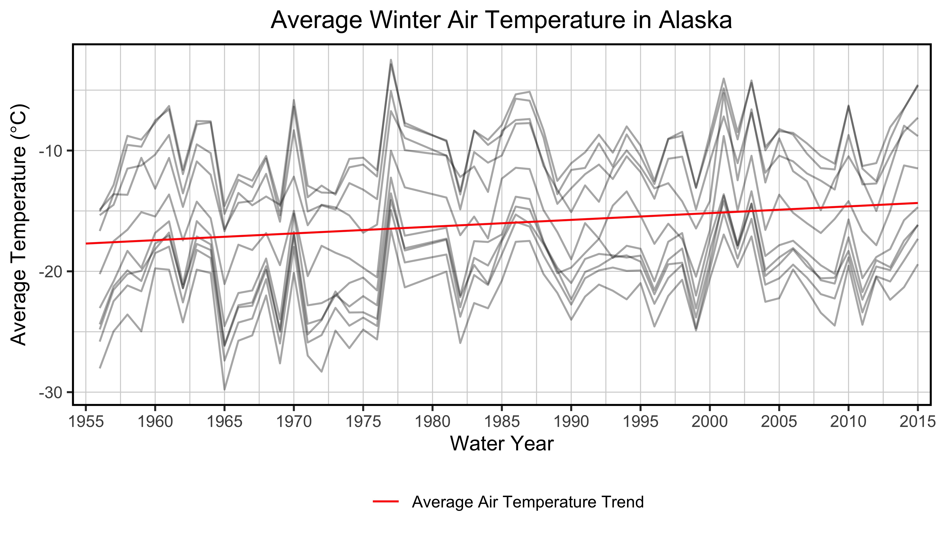
Warmer Air Temperature is Changing Alaskan Winter

Slide 7
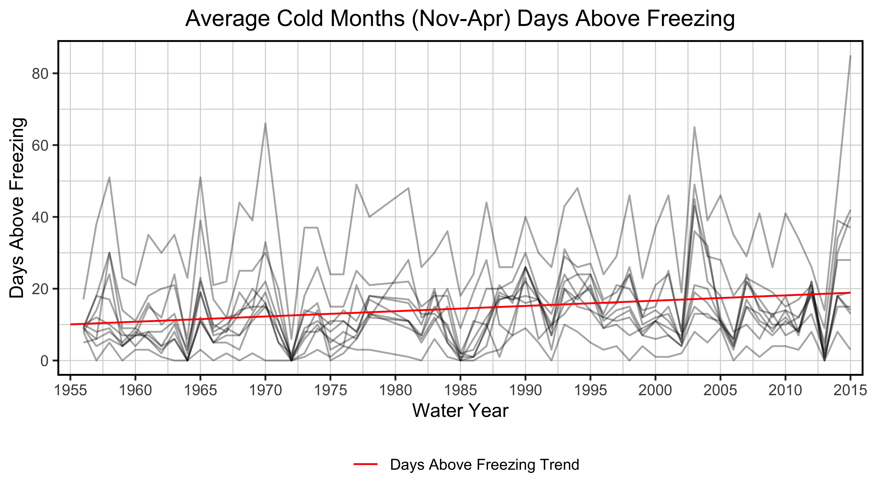

Slide 8
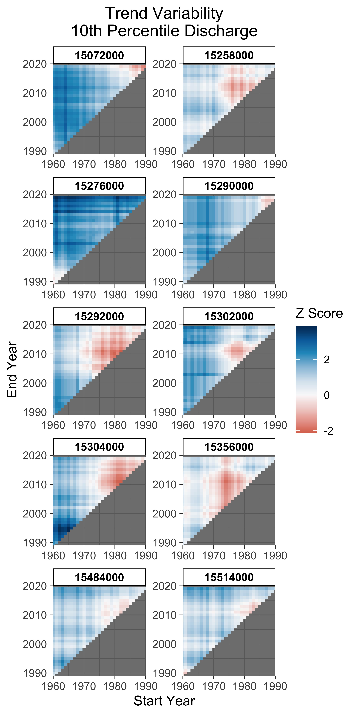
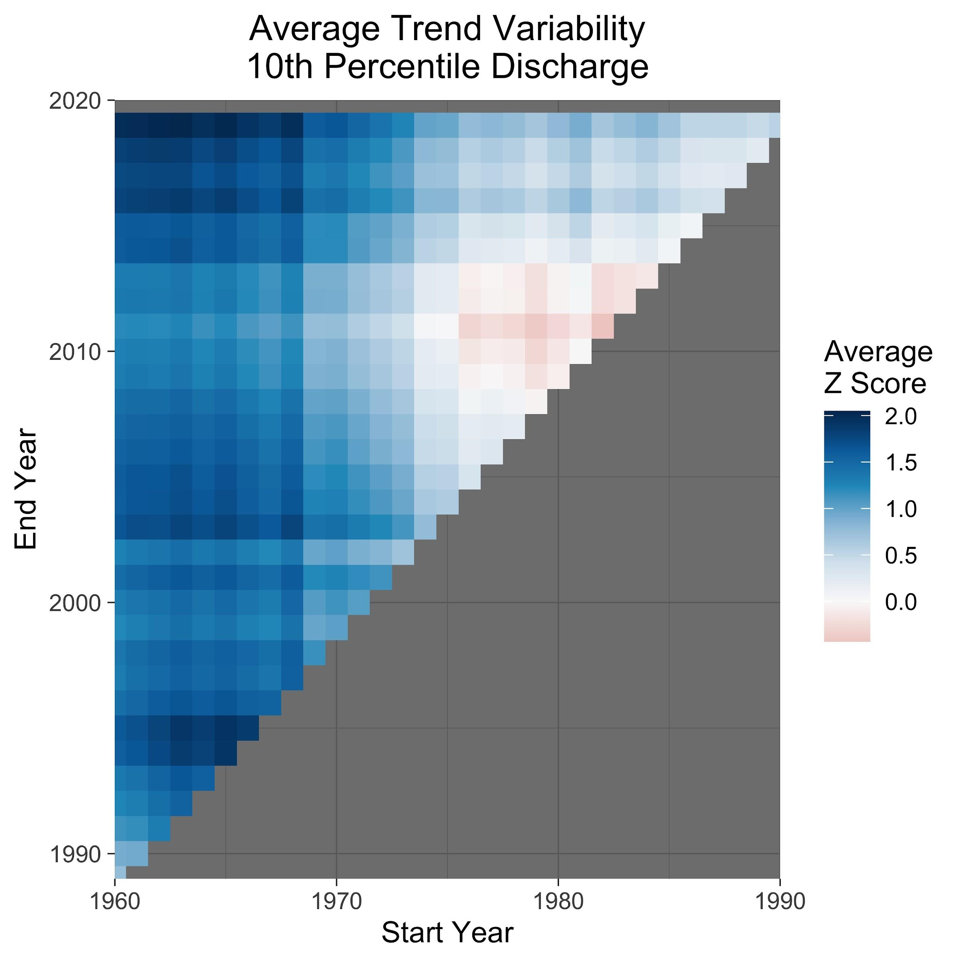

Slide 9
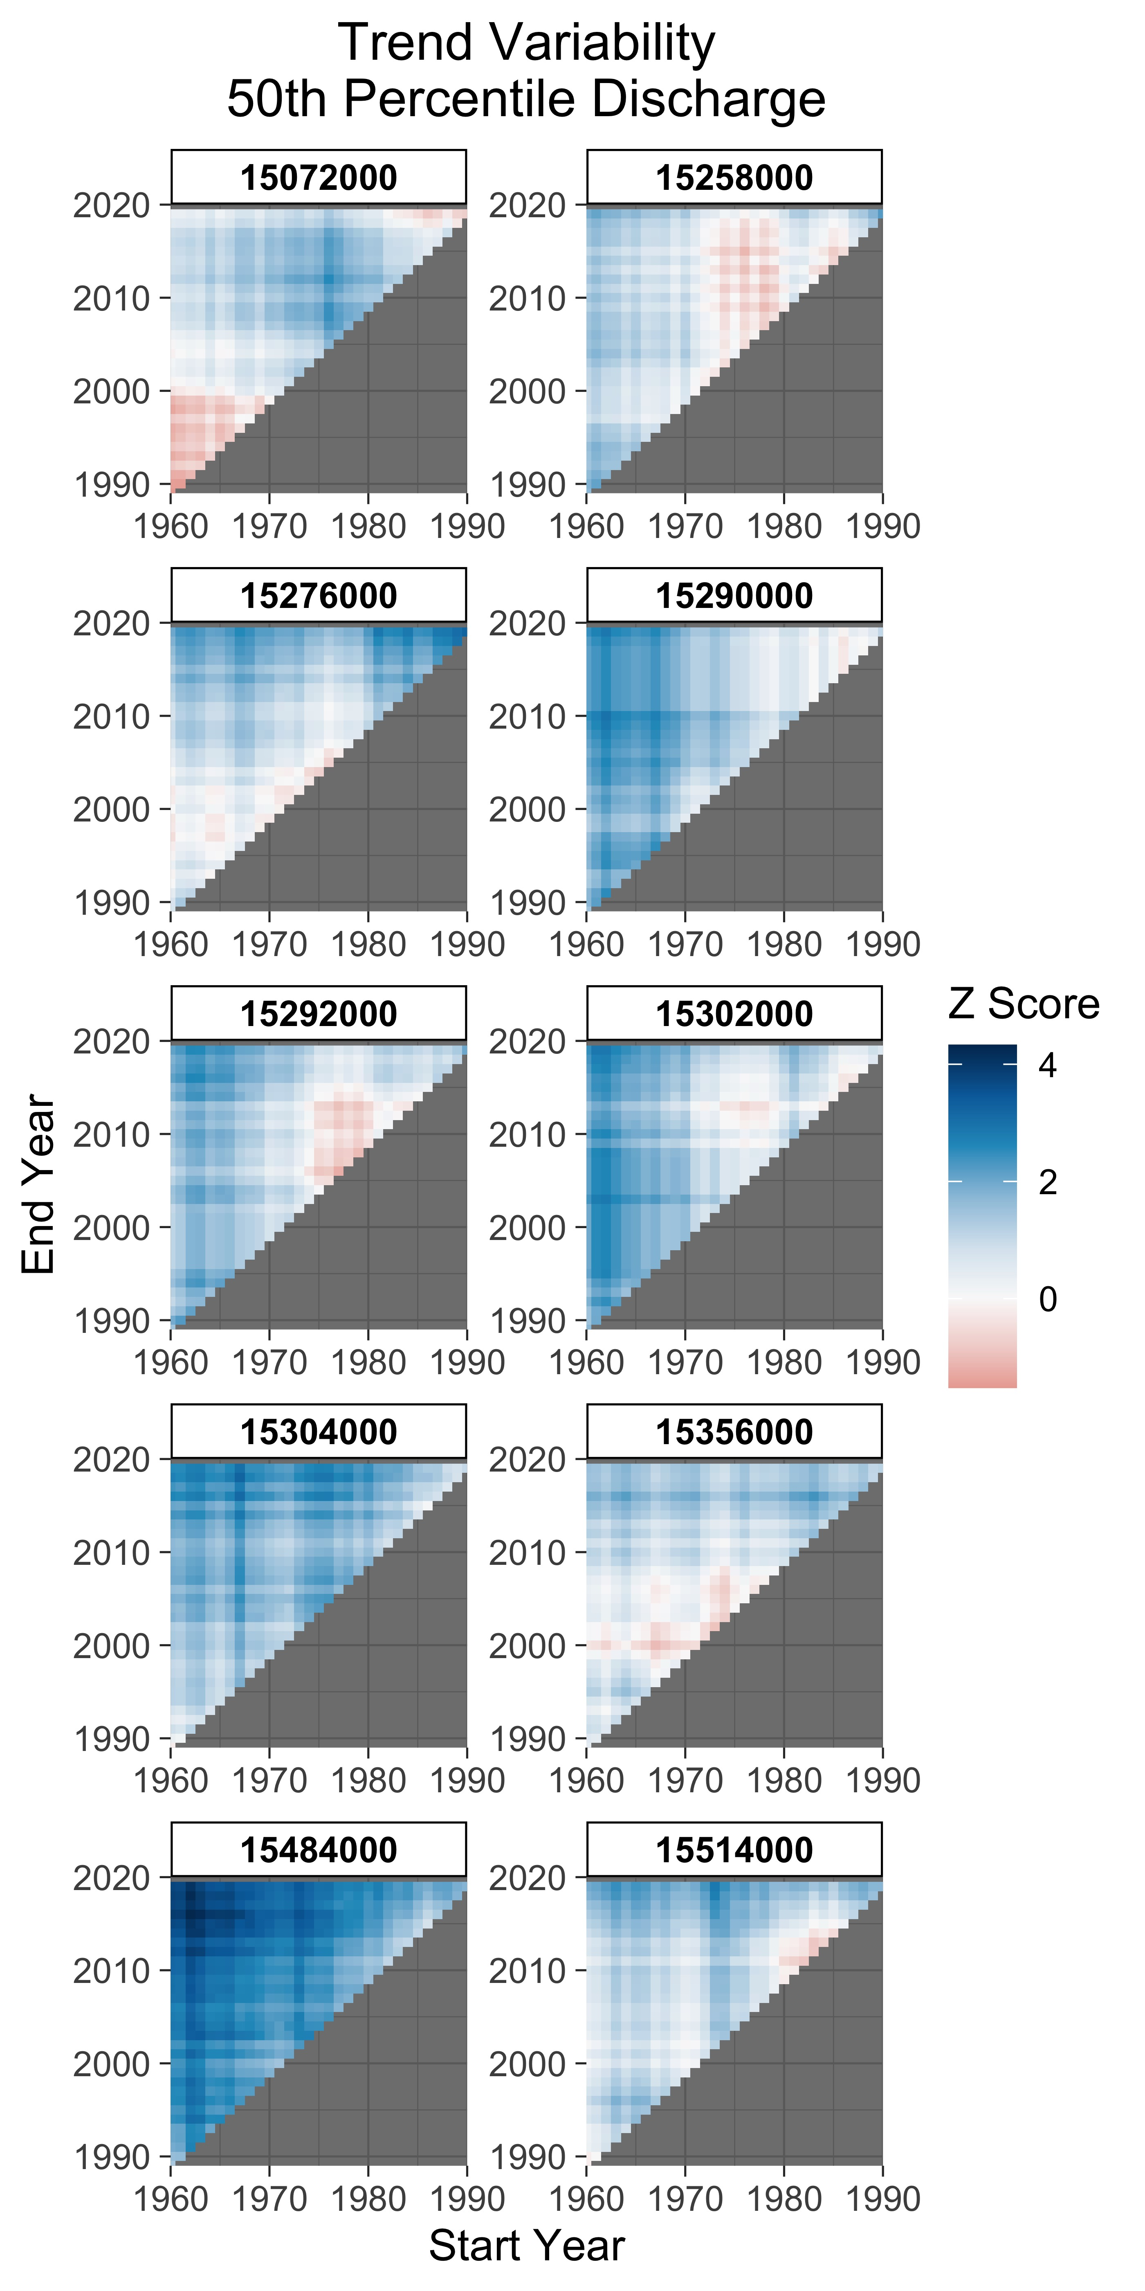
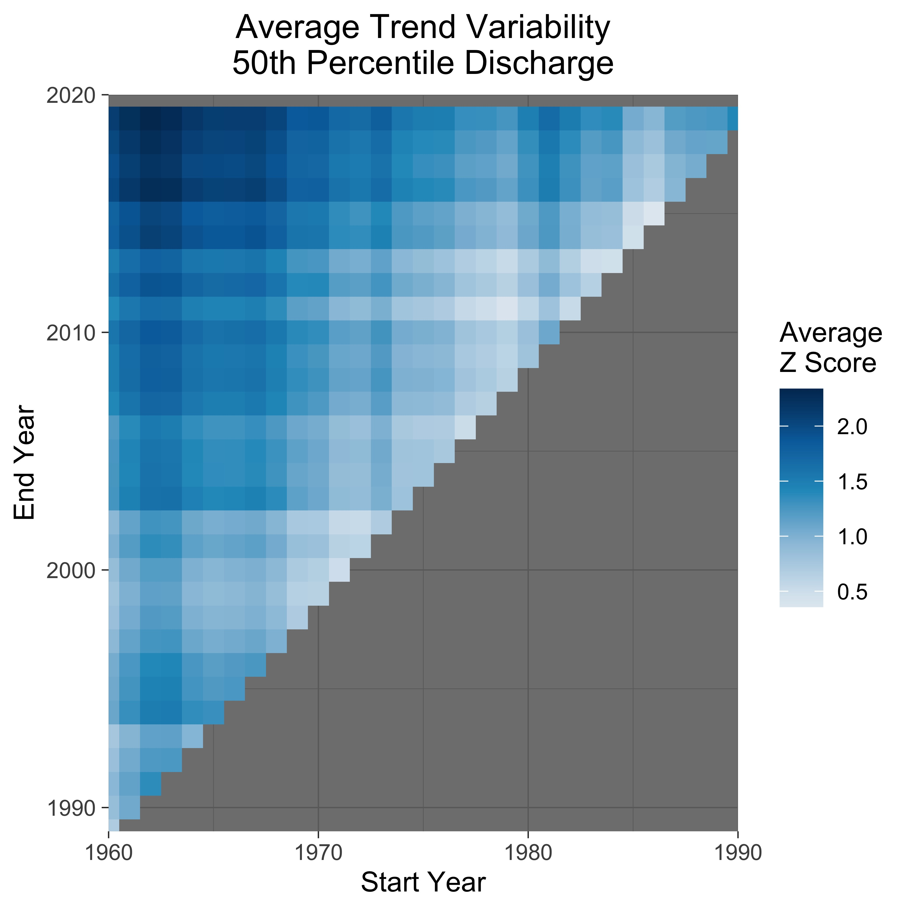

Slide 10
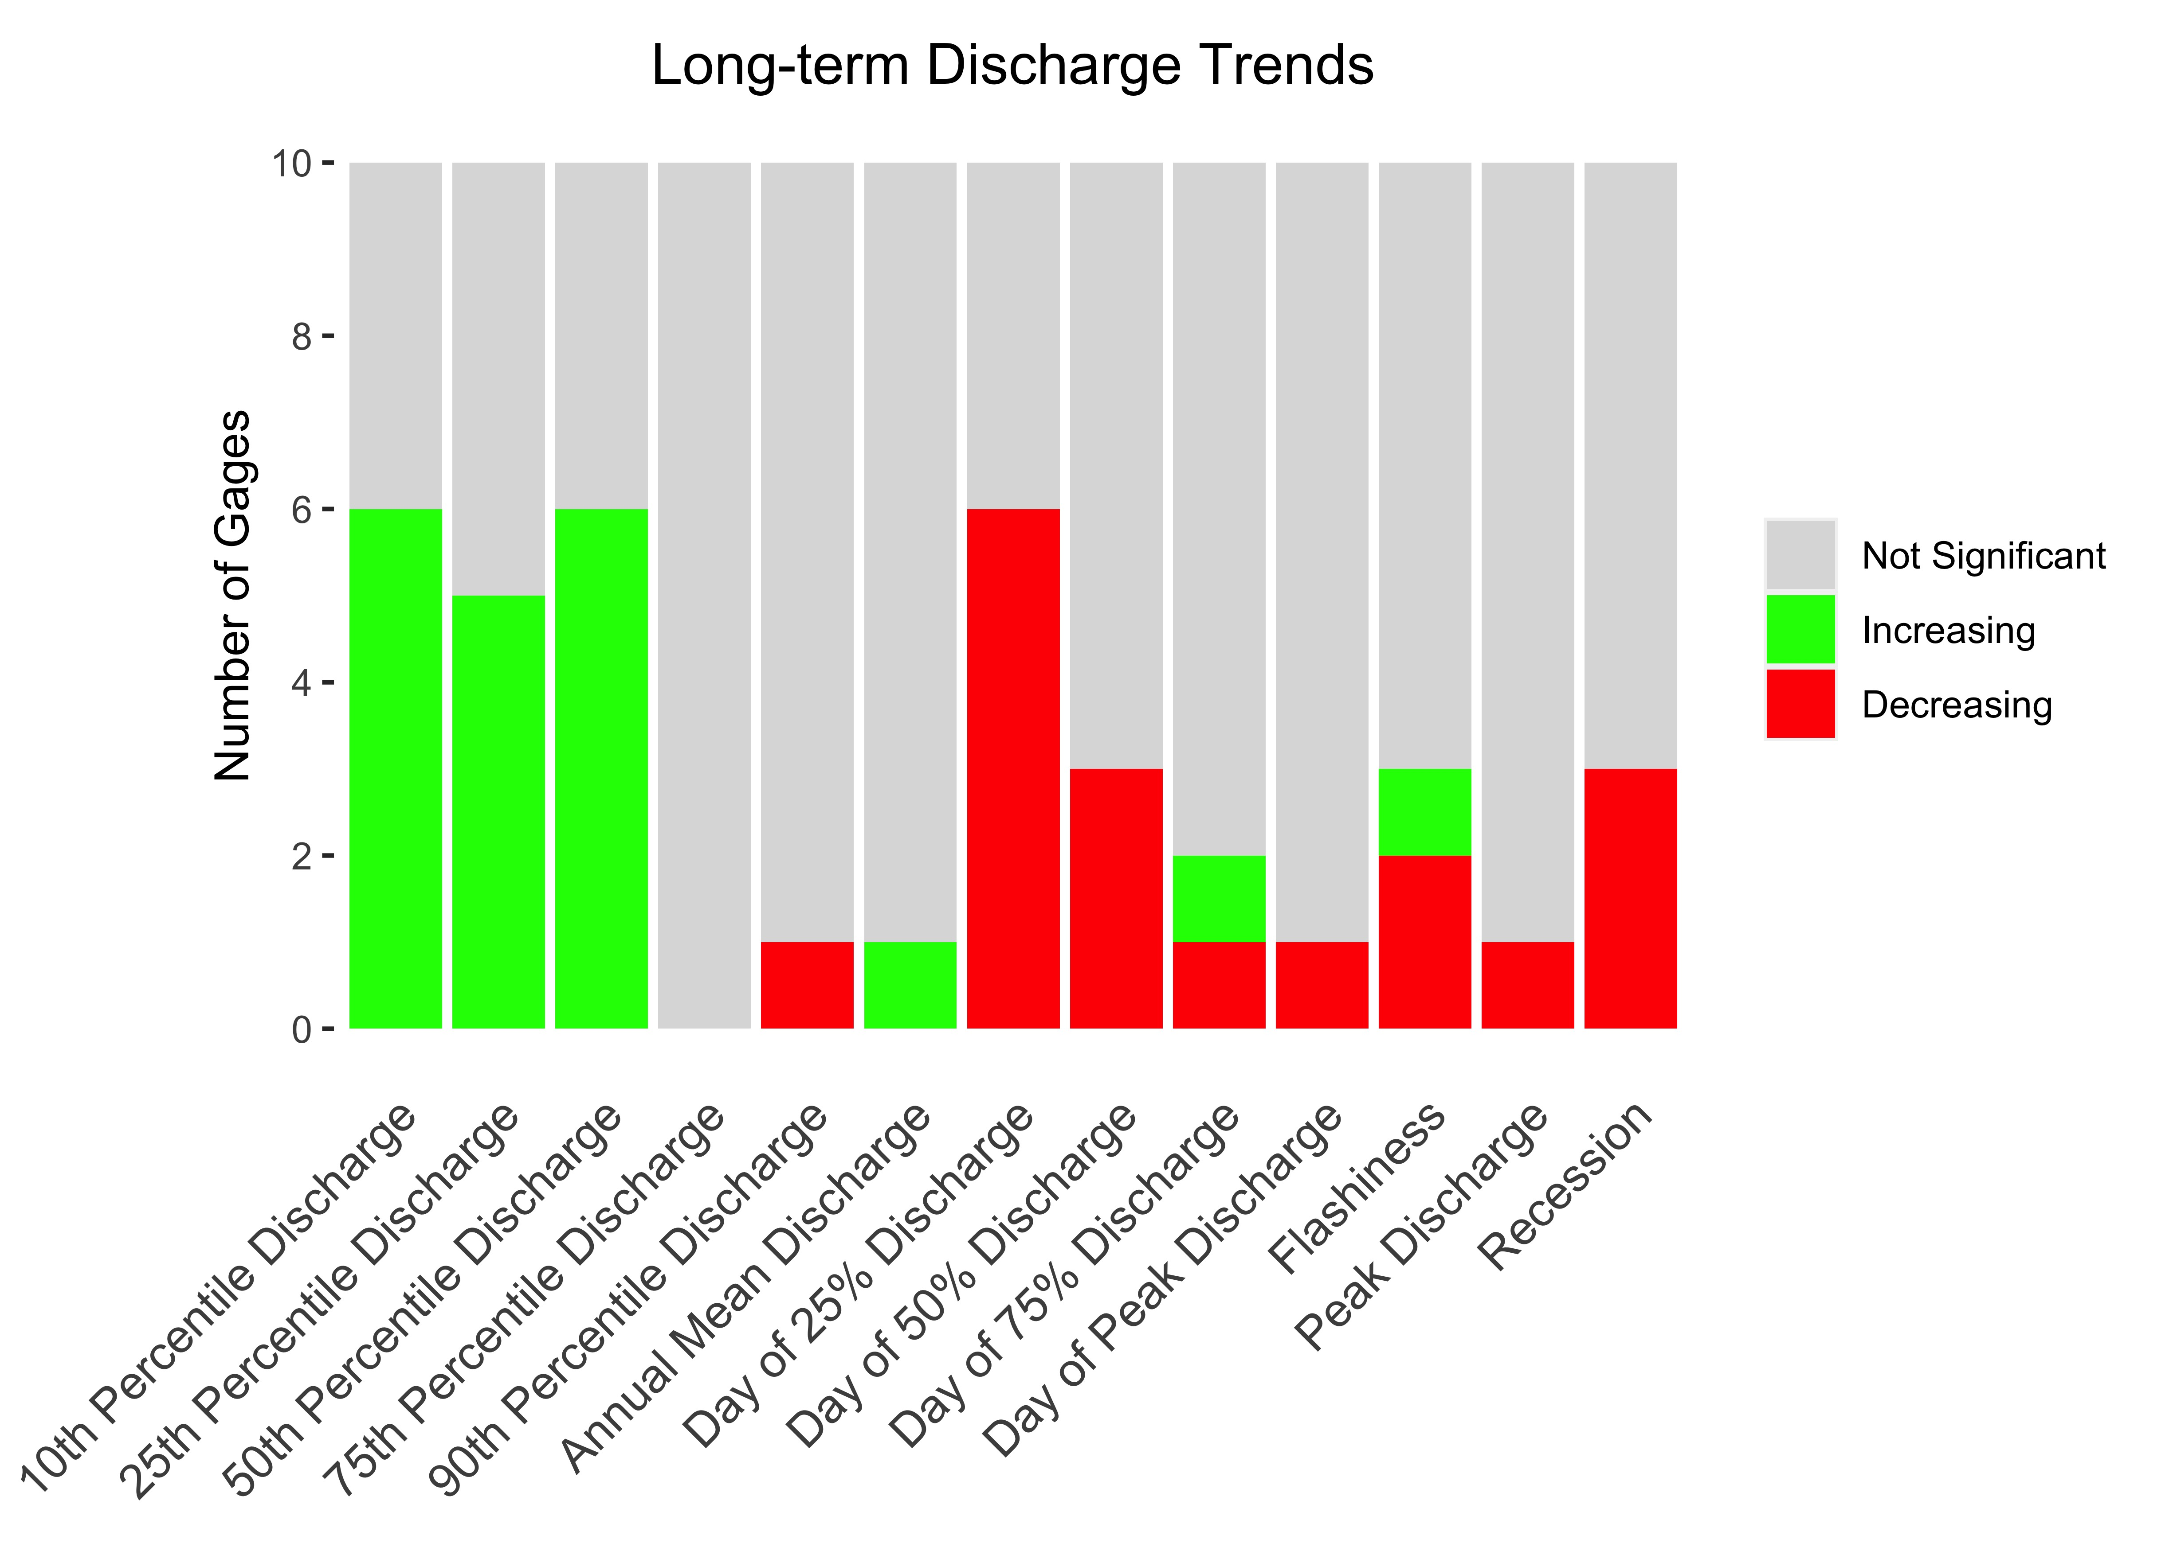
Low Flows Are Increasing Across Alaska
Notes:
Make y-axis by 2s, group type of analysis

Slide 11
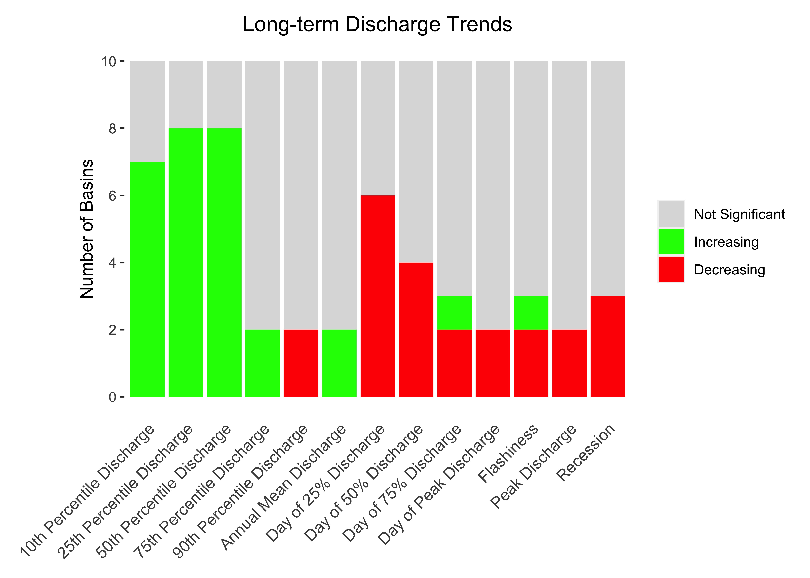
Low Flows Are Increasing Across Alaska
Notes:
Make y-axis by 2s, group type of analysis

Slide 12
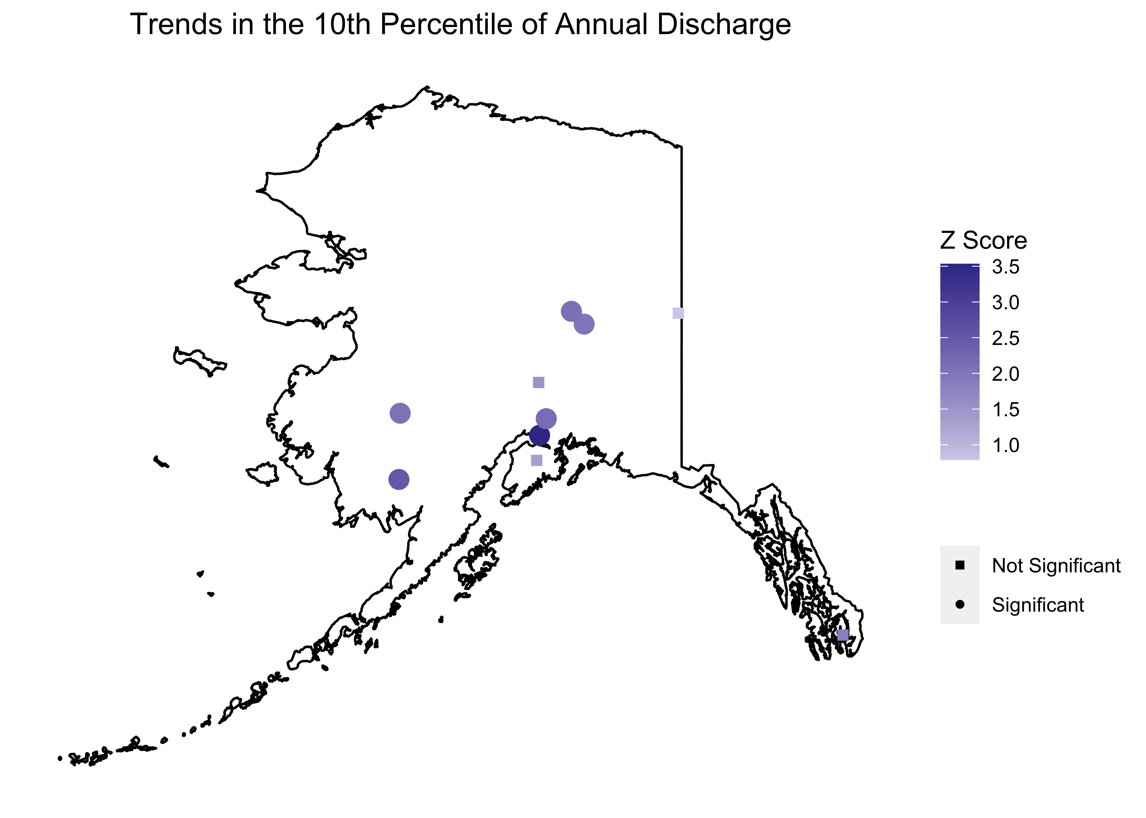
Low Flows Are Increasing Across Alaska
Notes:
Make y-axis by 2s, group type of analysis

Slide 13
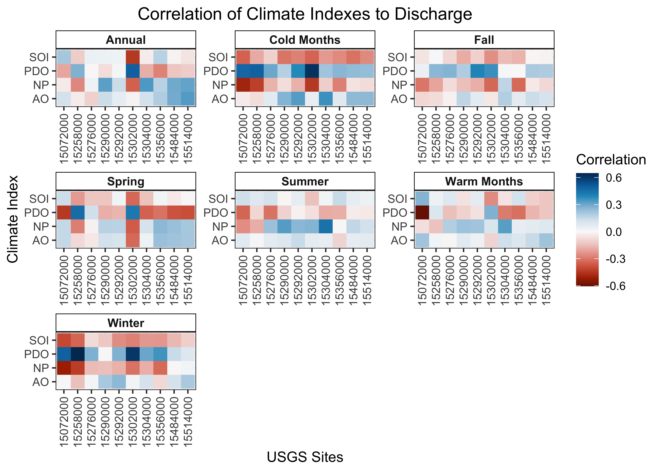
Some Variation in Discharge Due to Climate Fluctuations

Slide 14
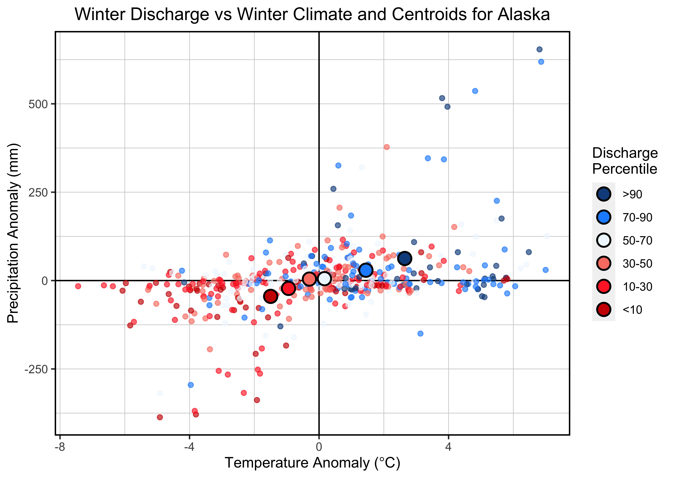
Winter Discharge is Highly Temperature Dependent

Slide 15
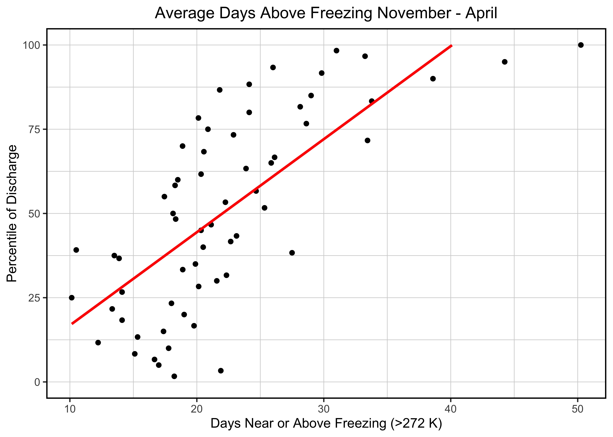

Slide 16
Conclusions
1.
Longer term records (>40 years) are needed to understand trends
2.
Low flows (≤50th Percentile) are increasing across Alaska
3.
Increasing winter temperatures causes increased discharge

Slide 17
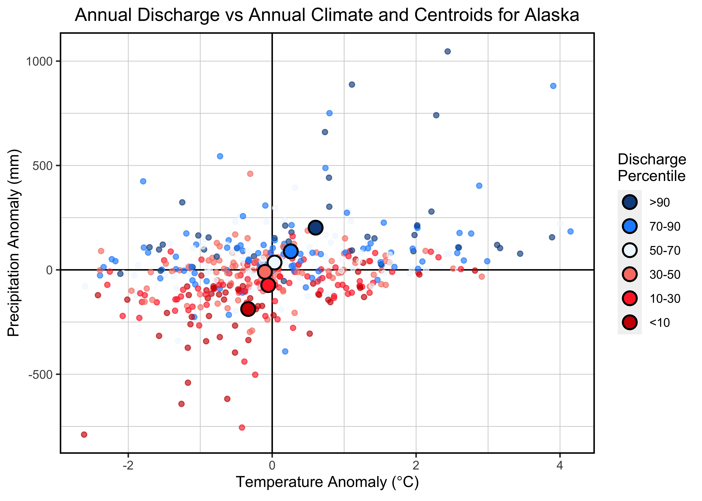

Slide 18
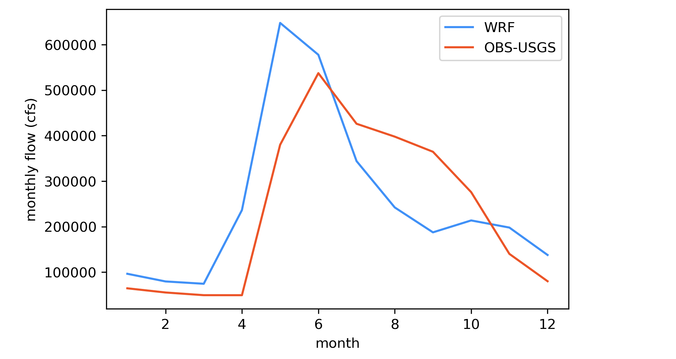
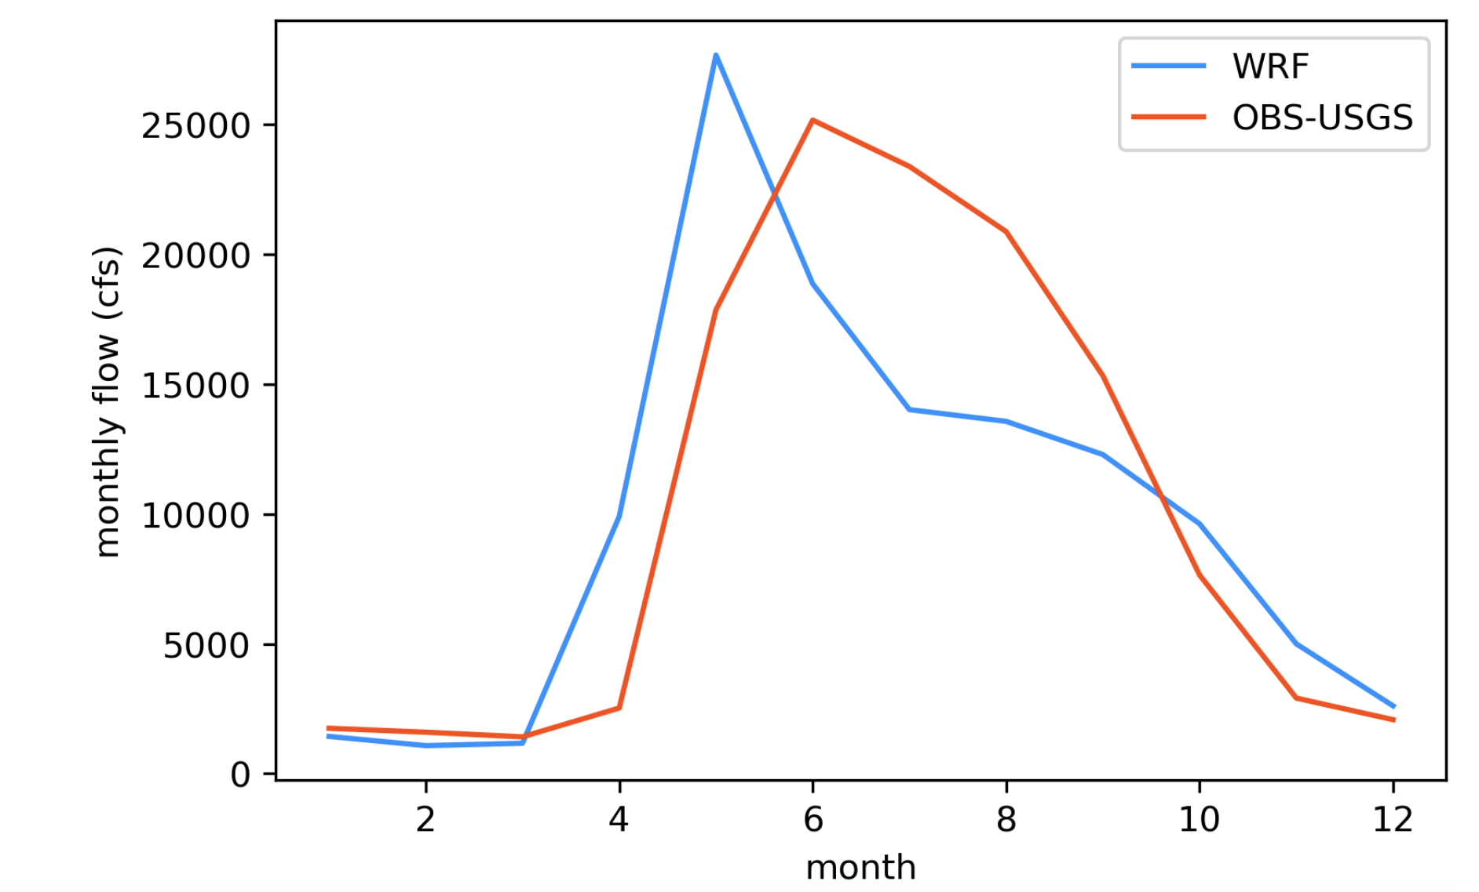
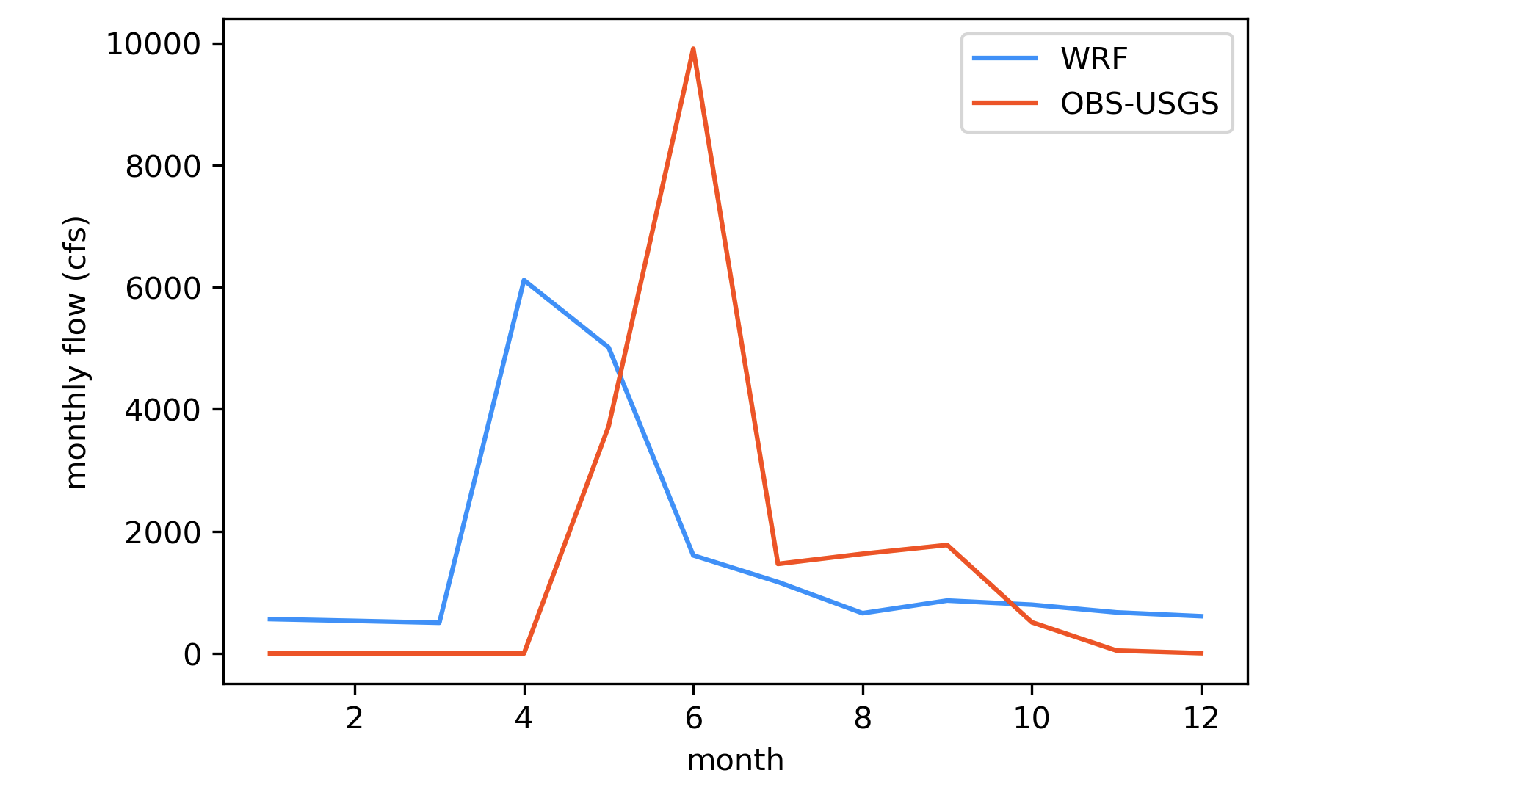
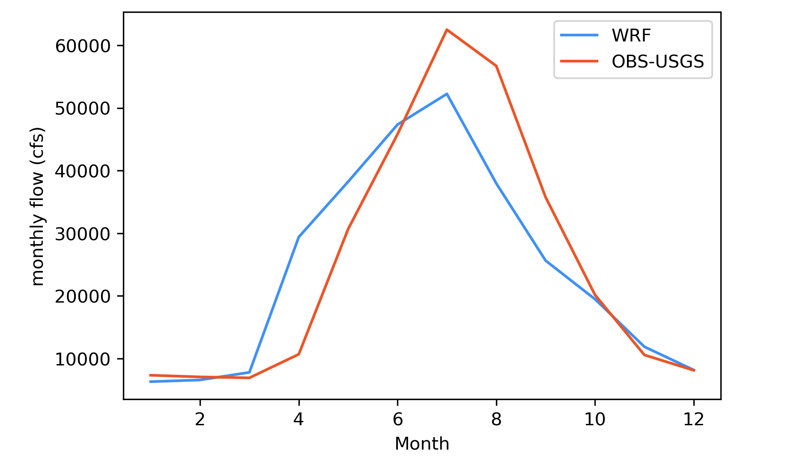

Slide 19
Project Goals
1.
How has river discharge changed within the observational record?
2.
What discharge record is need to understand long term trends?
3.
What are the drivers of river discharge change?

Slide 20
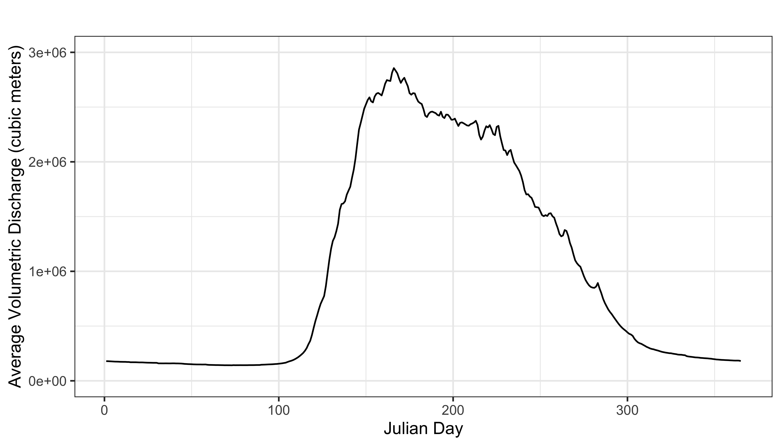
Metrics
Amount of Peak Discharge
90th Percentile = High Flows
-Only 36 days of the year have higher flows
50th Percentile = Middle Flows
10th Percentile = Low Flows
-Only 36 days of the year have higher flows
Day of Peak Discharge
Day of 25% Discharge
Notes:
Talk about metrics here. Periods of low flow we will define as 90th percentile and 10th percential. In figures remove percentile and say high and low flows.

Slide 21
Workflow
Clean
Visualize
Analyze
Download from USGS
Remove incomplete data
Group by decade and graph discharge
Plot trend stability
Changing high and low flows
Seasonal changes
Timing of peak

Slide 22
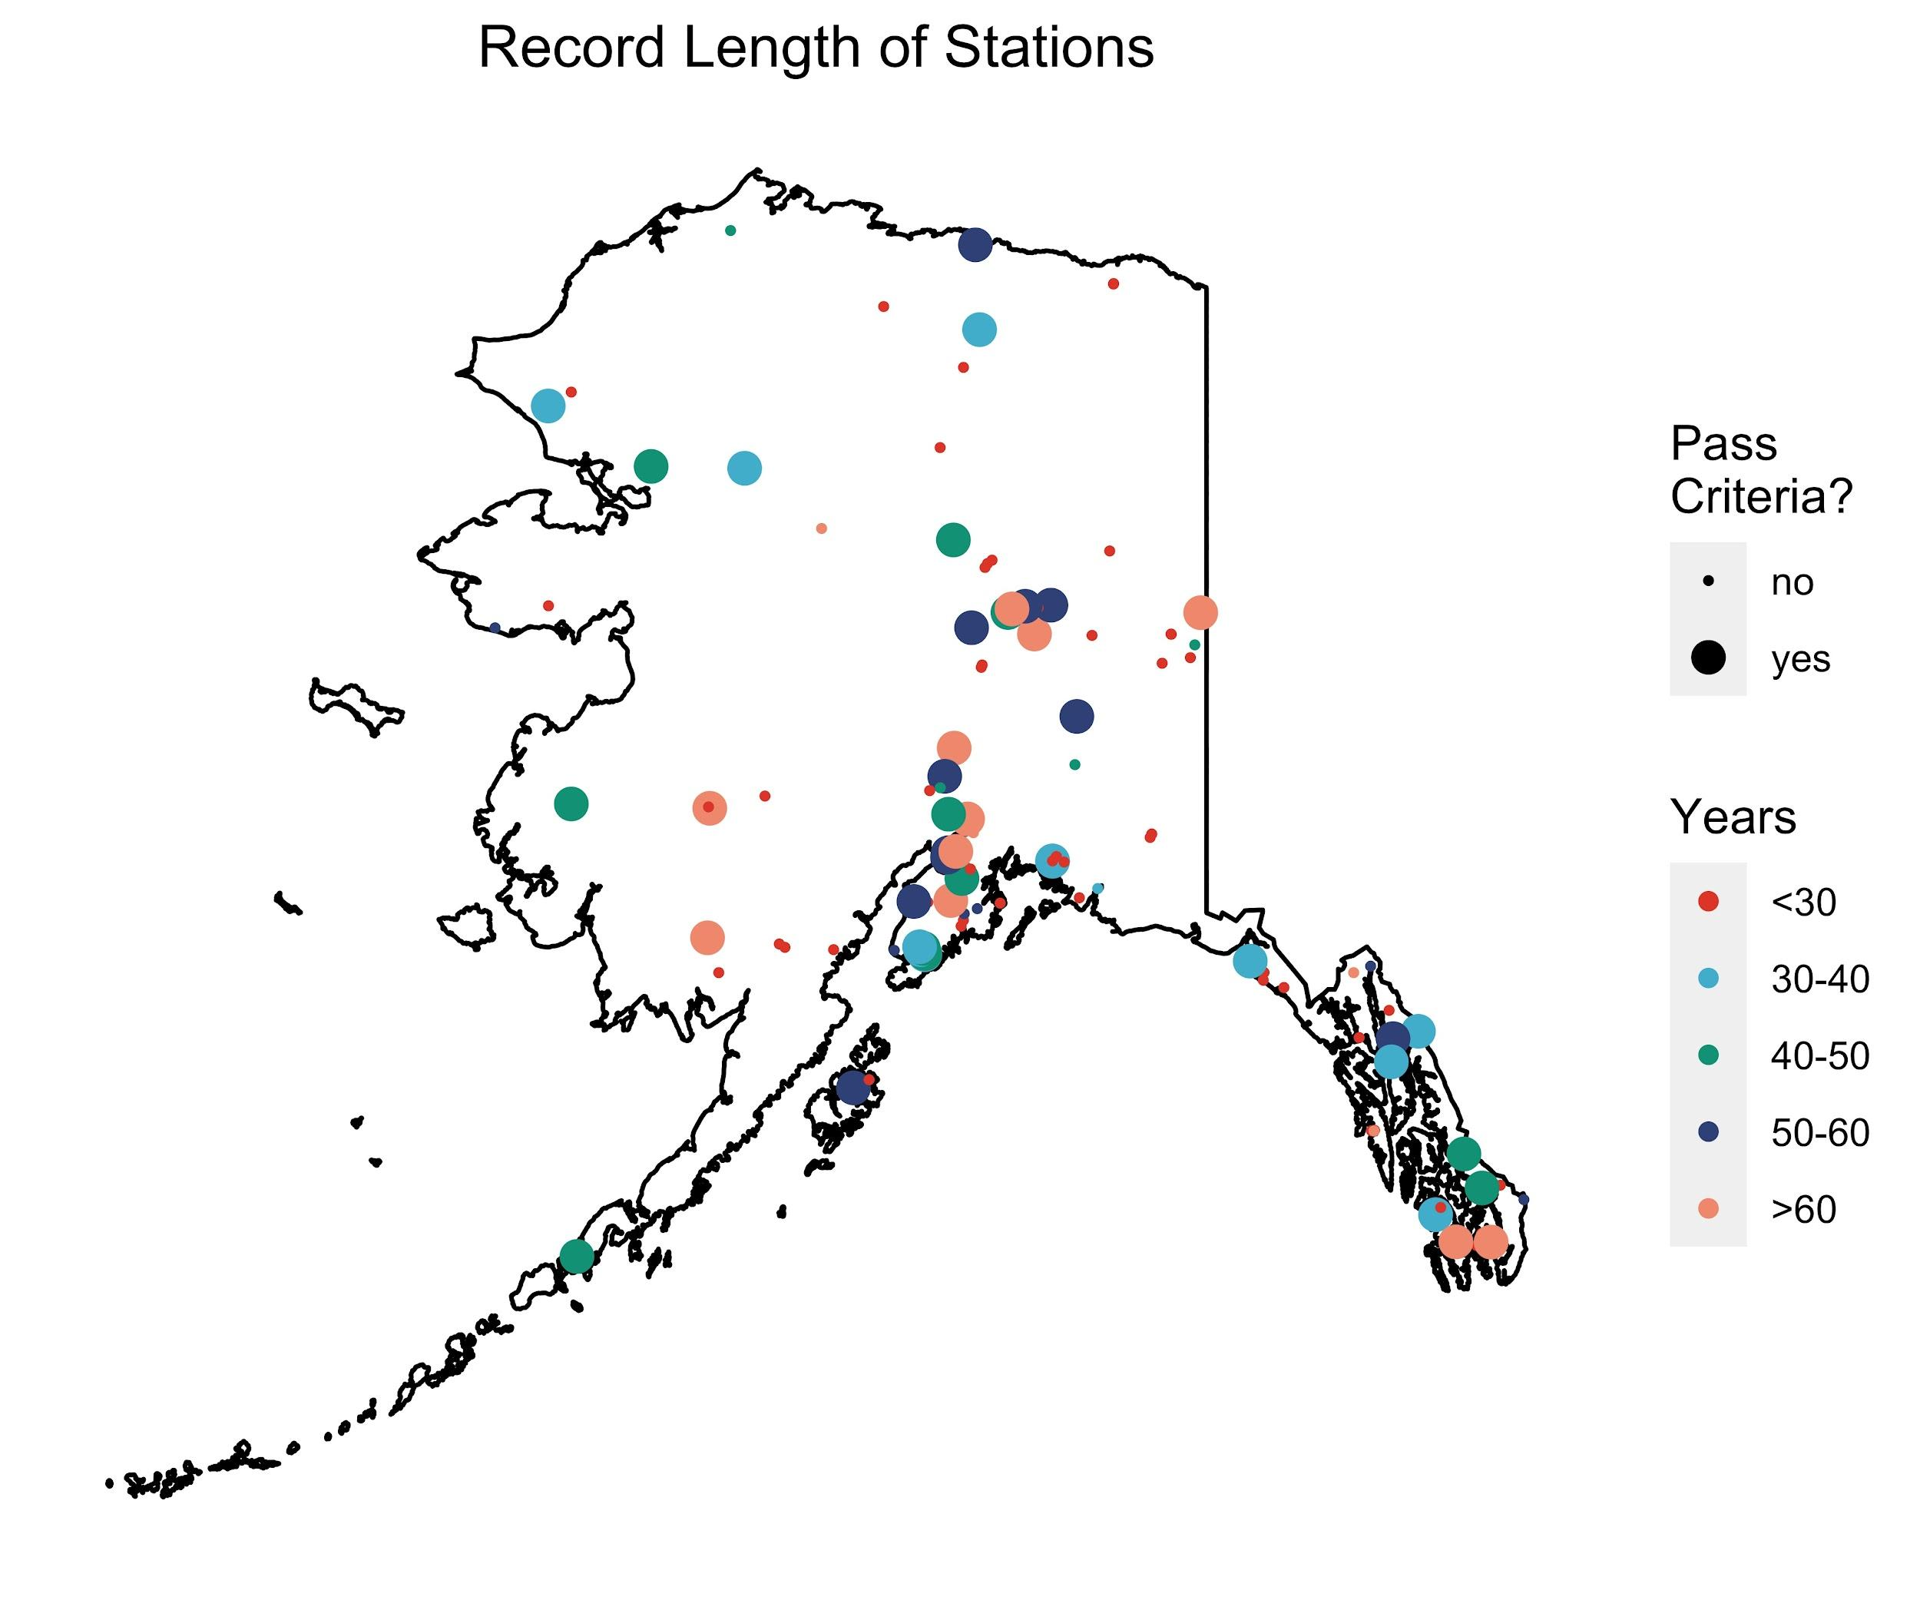
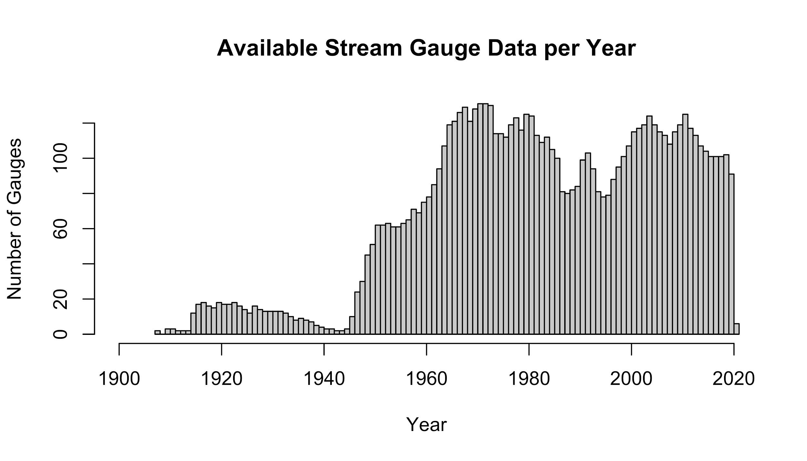
Data Availability
30 years: 40 gages
40 years: 26 gages
50 years: 19 gages
60 years: 10 gages

Slide 23

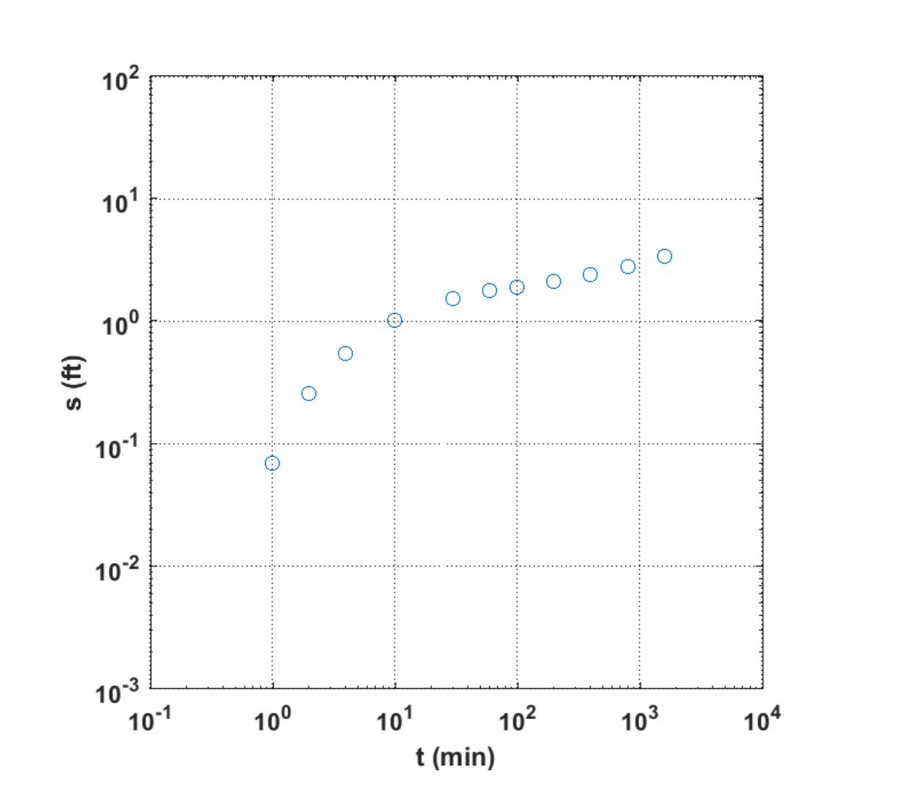

Slide 24
